Slide 1
Modular move to (best) fit

Slide 2
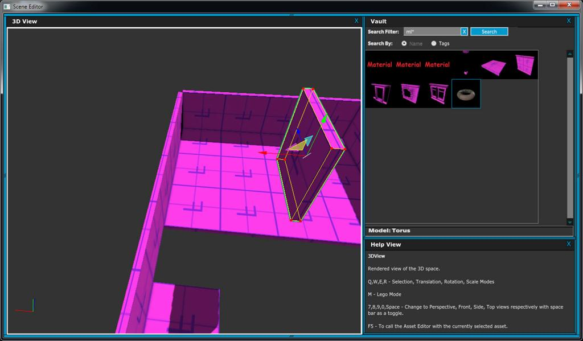
Moving objects in perspective requires a lot of “hunting”
Here, it would be very difficult to place the selected piece anywhere reasonable.

Slide 3
Moving objects in perspective requires a lot of “hunting”
Here, it would be very ifficult to place the selected piece anywhere reasonable.
But really, the user knows exactly where they want it t go.
exactly where they want it to

Slide 4
Moving objects in perspective requires a lot of “hunting”
Here, it would be very ifficult to place the selected piece anywhere reasonable.
But really, the user knows exactly where they want it to go.
…and, if we have context
information on the pi
then we know how this
piece is supposed to fit in f
the best/typical case.
information on the pieces,
d piece is supposed to fit in for

Slide 5
…and, if we have contex information on the piece then we know how this
piece is supposed to fit in the best/typical case.
Moving objects in perspective requires a lot of “hunting”
Here, it would be very ifficult to place the selected piece anywhere reasonable.
But really, the user knows exactly where they want it to go.
User selects this piece.
t
f
Hotkey for “move to best fit”
s,
d for

Slide 6
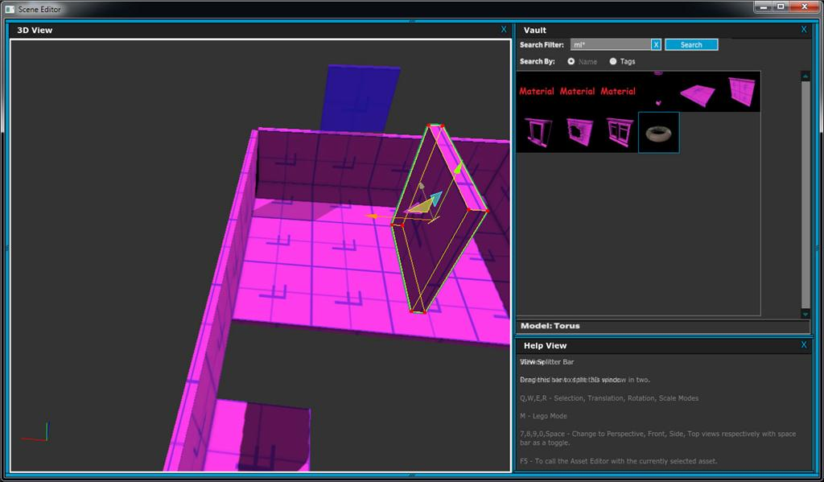
User mouse-over various positions shows ghosts of the places that it’s designed to connect to.
(This uses the same information as the modular stamp mode.)

Slide 7
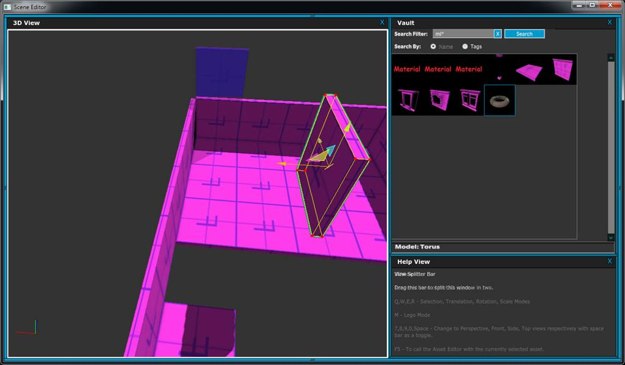

Slide 8
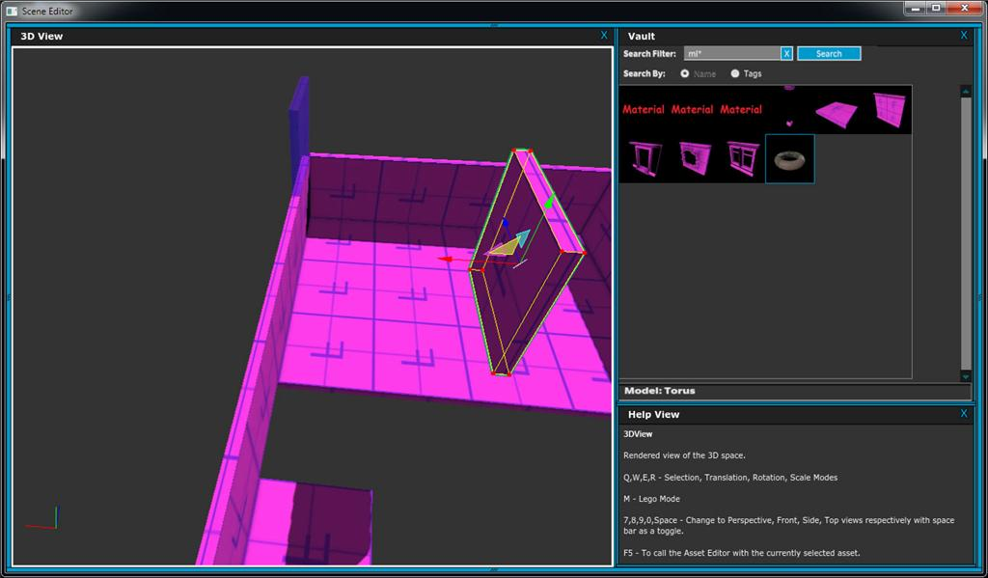

Slide 9


Slide 10
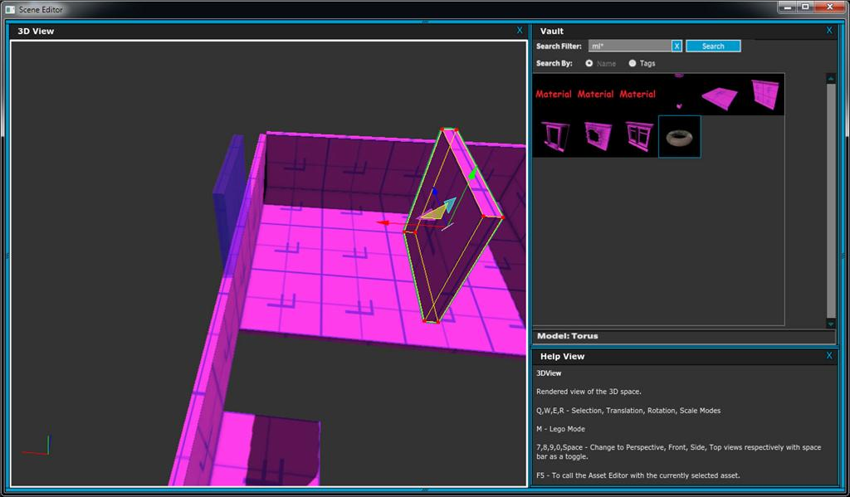
User mouse-over the location they want. Then click to move the piece there.

Slide 11
